Slide 1
Healthcare and Insurance Education
Larry the Porcupine
Sean, Melinda, Vrinda, Grace, and Ari

Slide 2


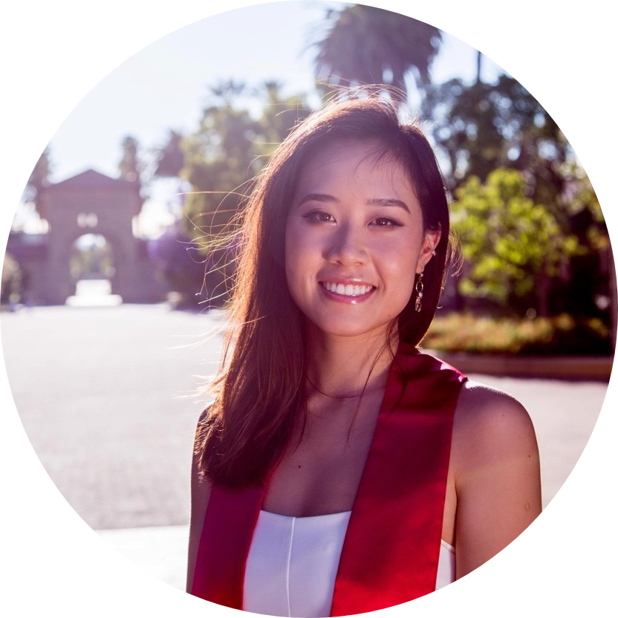

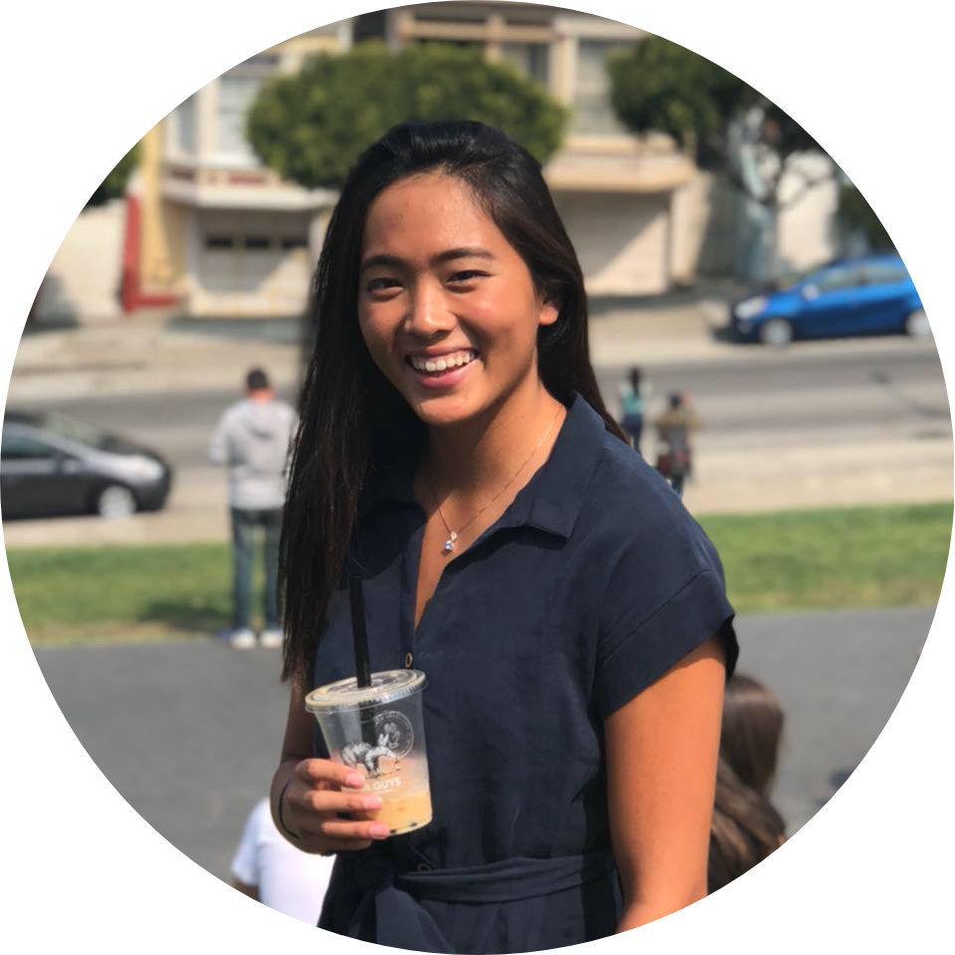
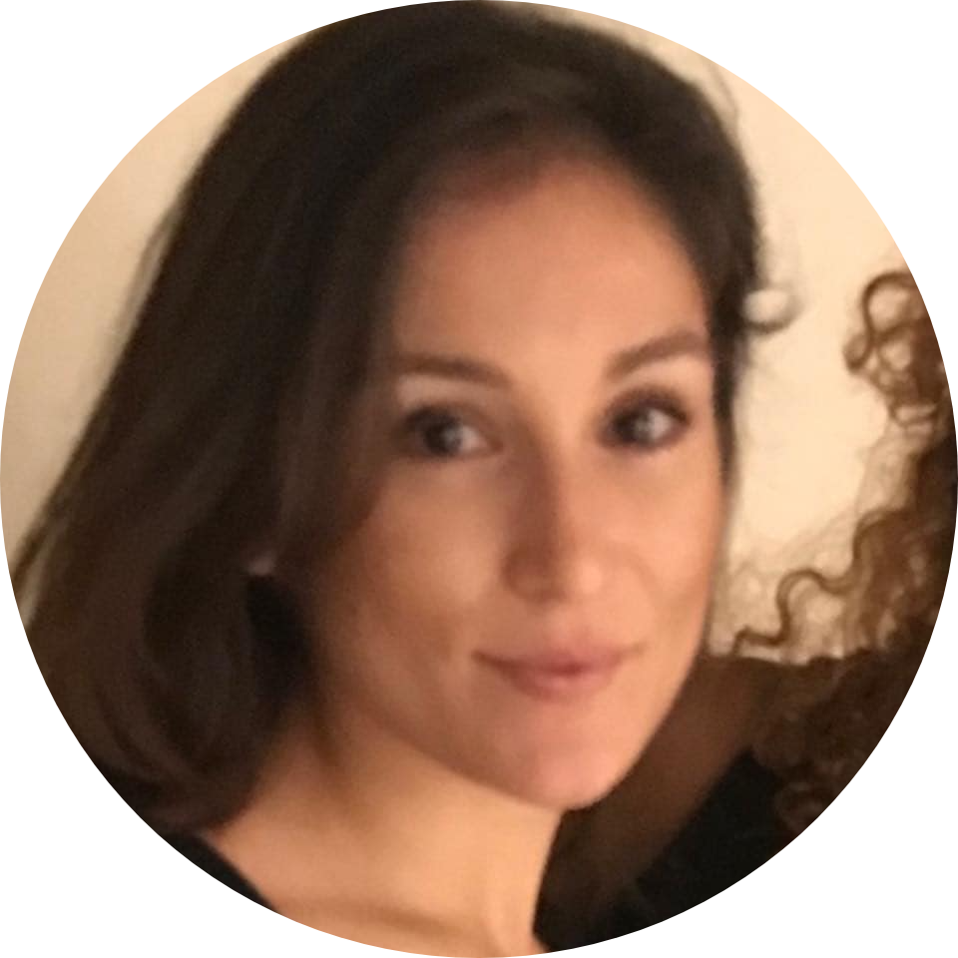
Meet Team Larry!
Sean
Melinda
Vrinda
Grace
Ari

Slide 3
Problem Domain
Young adults need higher quality and better access to healthcare and health insurance education
Notes:
(In particular, health insurance education is a leading barrier to better healthcare education)

Slide 4
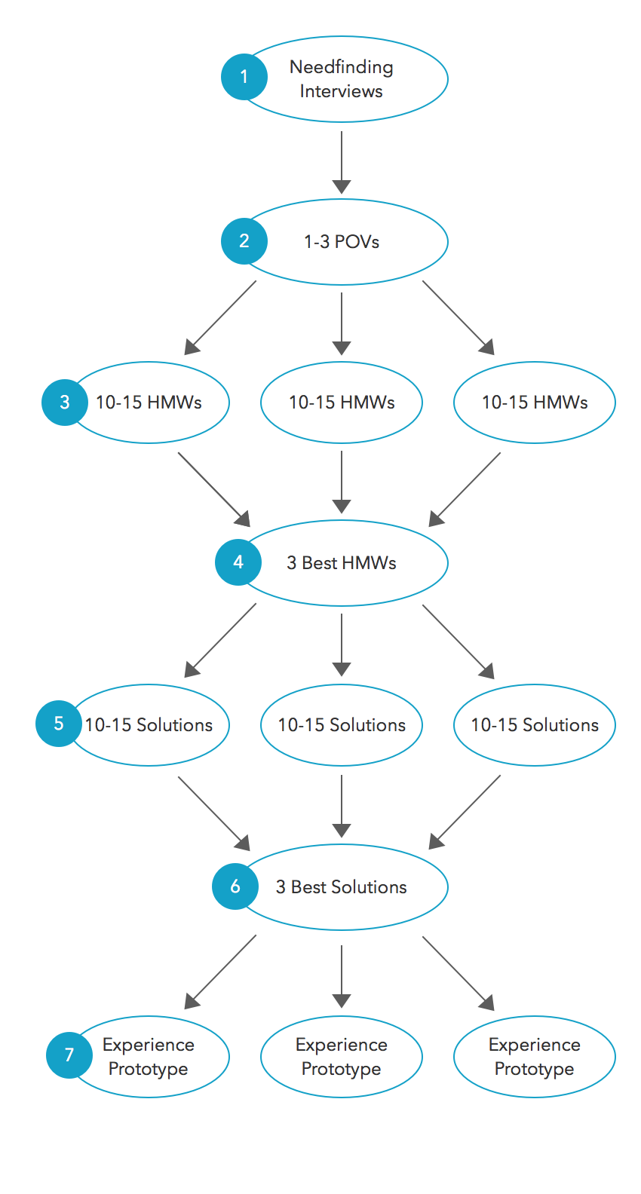
Overview
1
2
3
1
2
3
1
2
3
Notes:
In our process for this assignment, we came up with 3 POVs, 3 HMWs, and 3 experience prototypes…
It ended up being that they all matched up one to one, so it makes sense to talk about them in this order (POV #1, HMW#1, EP#1, then POV #2, HMW#1, … etc)

Slide 5
We met…
Kaori, a college student who has a few trusted doctors maintaining her healthcare.
We were surprised that…
she found herself lucky to find a good relationship with a doctor she chose based on convenience.
It would be game changing if…
we could help take the luck element out of establishing a trusting patient/doctor relationship.

Slide 6
How Might We…
Take advantage of Kaori's trusted and extended network to recommend doctors that are more likely to be compatible with her?

Slide 7
...Solution
Connect with network of similar people, and see which doctors they liked.
Submit reviews/debriefs after each doctor visit.
Automatically filter out doctors that aren't supported by her insurance.

Slide 8
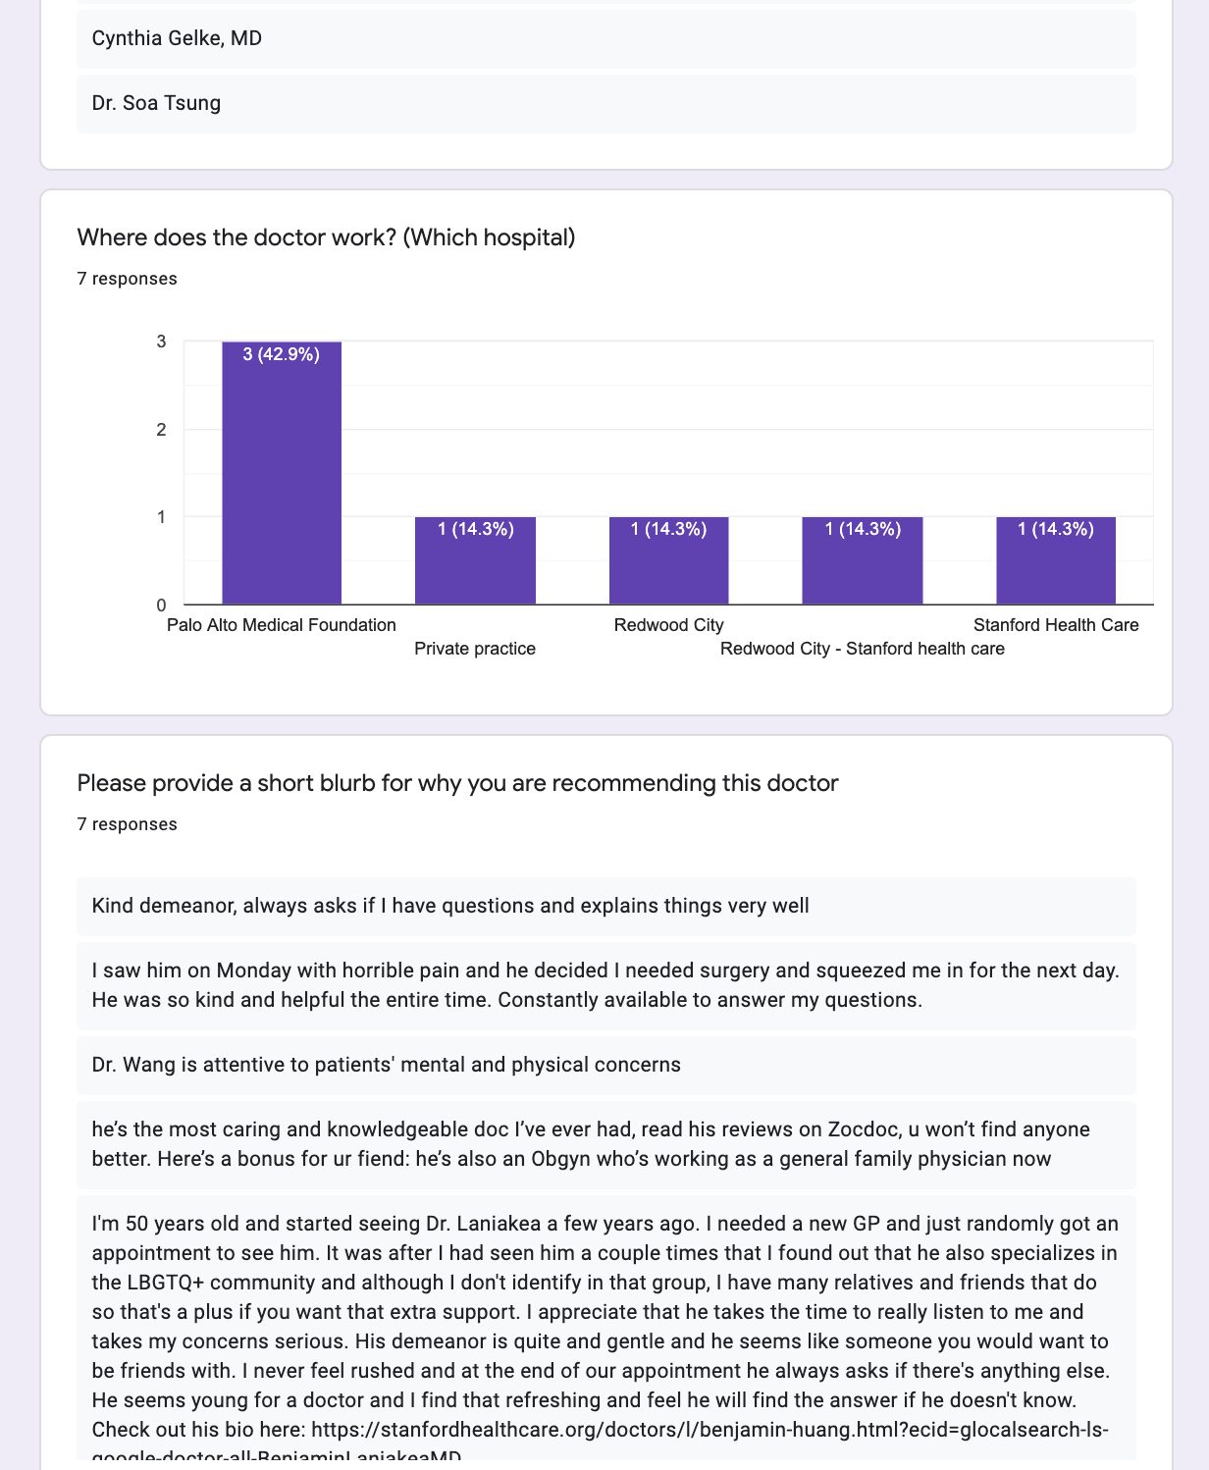
Experience Prototype 1
Prototype: Doctor recommendations sent in via Google forms pooled from trusted network and Nextdoor
2 young adult females looking for a doctor in the Bay Area and friends and local Nextdoor users who submitted recommendations

Slide 9



Experience Prototype 1
Assumption: People would trust recommendations from others in their network without knowing them/meeting them.
Confirmed: Participants trusted results after knowing the source and recommenders’ demographics.
Results:
Would like verified information on doctor’s practices as well as their bios.
Received conflicting feedback for information preference
recommendations presented as a quick read (highlights) vs detailed testimony
Notes:
Moving on to our next POV...

Slide 10
We met…
Anna, a student who had to switch insurance when going to college and who will be switching again when she gets a job.
We were surprised that…
she is scared of getting a job because it would negatively impact the standard of care she is used to getting.
It would be game changing if…
we could help her maintain the same level of care through her health insurance transition.
Notes:
Changed kaori to anna to avoid confusion

Slide 11
How Might We…
Help Anna maintain her level of healthcare during a transition of health insurance and inform Anna of what is/isn't covered under a new insurance plan?

Slide 12
...Solution
A smart match mentorship and education program:
Healthcare experts
People who went through similar situations
Mentee

Slide 13
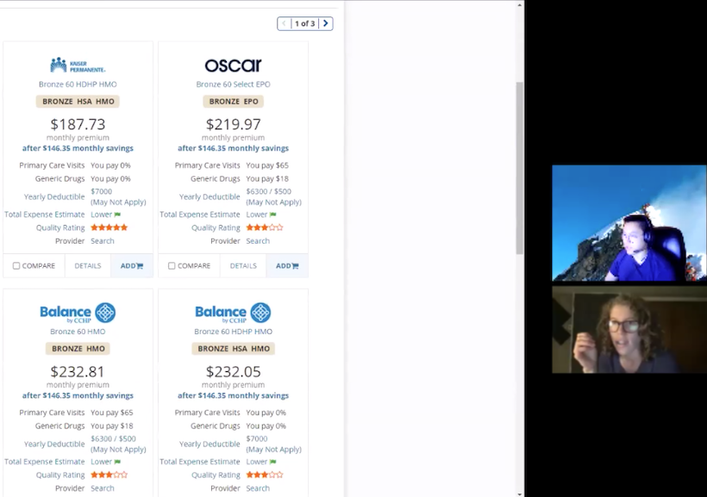
Experience Prototype 2
Prototype: Match mentor/expert and mentee to discuss an upcoming insurance transition over a 30 minute Zoom call with mentee follow-up
Mentor with experience transitioning health insurance and new grad exploring health insurance options
Notes:
Prototype 2:
Facilitate 30min Mentor/Mentee Zoom call
Mentee = upcoming insurance transition, new grad (top)
Mentor = expert in insurance, has experience transitioning (bottom)
Match mentee with insurance based off of engagement
Without even prompting, started comparing insruacnes on comparecalifornia website

Slide 14
Experience Prototype 2
Assumption: Young adults would trust a mentor/expert they are matched with online
Confirmed: With sufficient mentor credibility, mentees trusted mentors during 1-on-1 calls
New assumption- Young adults are willing to be vulnerable to mentors they’re matched with
Results:
Introductions and sharing background helped establish credibility from the start
Although mentee trusted mentor, mentee had different expectations of how conversation would go (such as different questions in mind)
Notes:
Mentor navigated plans twice in companies
Noticed that mentee was quick to be honest (like to further test)
Mentee had different expectations for questions/topics covered, but was pleasantly surprised by how it went and trusted mentor

Slide 15
We met…
Irene, a recent grad who started a new job and had to navigate health insurance for the first time.
We were surprised that…
even though Irene reached out to her trusted network for info/advice, she still isn't quite sure how to use it and if she made the right choice.
It would be game changing if…
we could help Irene feel confident that she is getting the most out of her insurance, and that it is the best option for her.
Notes:
AQ: I would bold but in a different color like orange or something fun - not black

Slide 16
How Might We…
Leverage communal and expert knowledge to teach Irene how to get the most out of her plan?

Slide 17
...Solution
A Reddit for healthcare insurance: post your plan and get feedback/voting from the community.
Discussions of best places to get care and how to best use insurance
Organize by insurance plan, location, demographic
Moderators & community guidelines for public forums

Slide 18
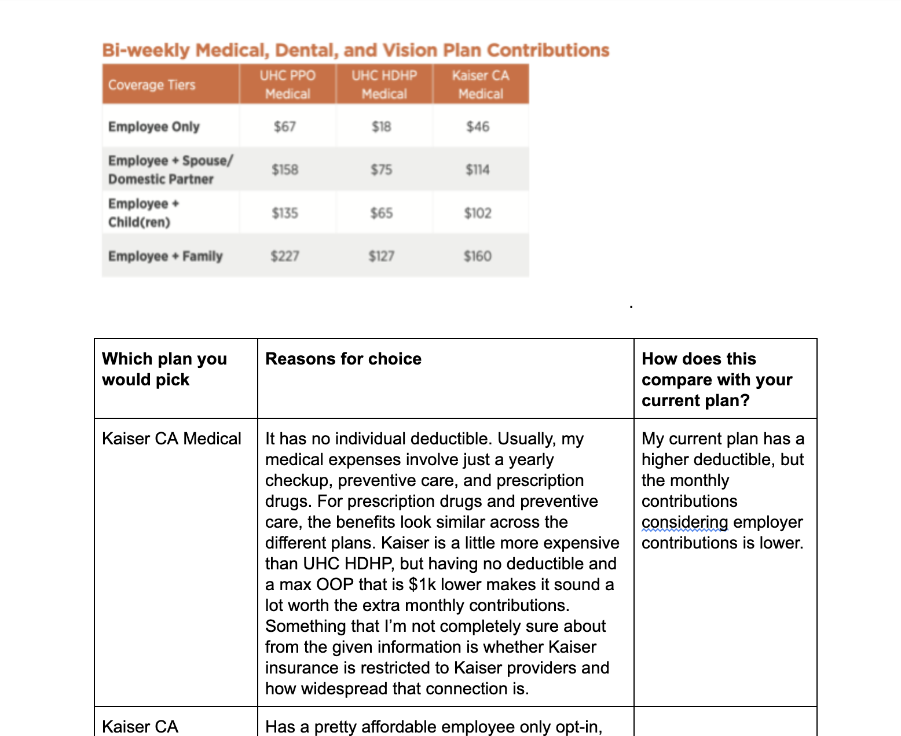
Experience Prototype 3
Prototype: Experienced contributors give feedback on anonymized insurance plan via a shared Google Doc
3 young adult females working a tech job and contributors with experience navigating health insurance for themselves and their families
Notes:
Google doc:
Participants have basic description (YA, bay area, relatively healthy)
asking contributors to introduce themselves, stating why they chose their current plan, then which plan they would choose for participants and why (and optionally a comparison of that plan and contributor’s own current plan)

Slide 19
Experience Prototype 3
Assumption: People would be comfortable anonymously posting their insurance plan and trust other people's feedback
Confirmed: participant felt comfortable sharing anonymized insurance plan
Results:
Participant found reading other people’s logic and reasoning flow helpful
Reading the commenters’ reasoning in choosing their own insurance plans contributed most to their trustworthiness
Notes:
Biggest contributor to trust was #2

Slide 20
Thank you! Any questions?

